Slide 1
THE BASAL GANGLIA
IN CONTROL OF MOVEMENT

Slide 2
STRUCTURE OF BASAL GANGLIA
The basal ganglia are a group of subcortical nuclei located primarily in the base of the forebrain.
Its composed of
  The striatum,
  Globus pallidus,
  Subthalamic nucleus, and
  Substantia nigra
Basal ganglia action influences the entire motor system and plays a role in;
  The preparation and
  The execution of coordinated movements.
Input is from
  The cerebral cortex, and
Output is directed to;
  The motor cortex and
  Brainstem areas concerned with movement

Slide 3
STRUCTURE OF BASAL GANGLIA
The Corpus striatum is made up of
  The caudate nucleus
  The putamen, and
  The globus pallidus
The Caudate and Putamen are histologically similar just separated by the anterior limb of the internal capsule.
The Putamen and Globus pallidus are collectively referred to as the Lentiform nucleus.
The globus pallidus (GP) has two subdivisions:
  The external segment (GPe), and
  The internal segment (GPi).
The Substantia Nigra also consists of 2 parts
  The Pars Reticularis (SNr)
  Pars Compacta. (SNc)

Slide 4
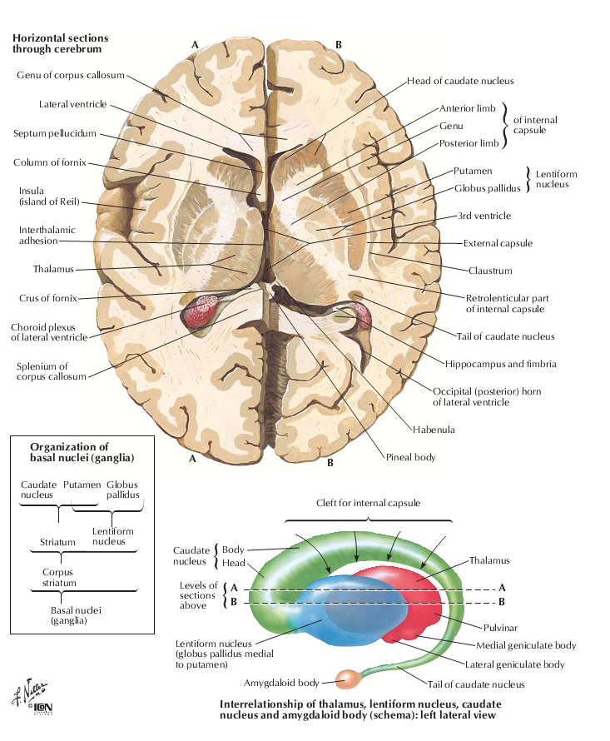

Slide 5
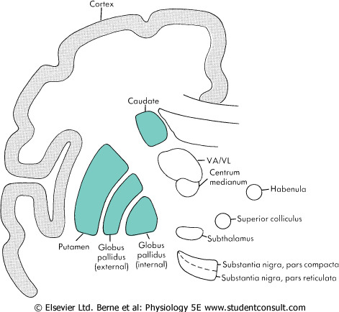

Slide 6
CIRCUITRY OF THE BASAL GANGLIA
It can be simplified into input, output, and internal pathways.
INPUT
Input from the cerebral cortex is excitatory somatotopic (glutaminergic) and directed to the striatum and the Subthalamic nucleus.
The medium spiny neuron is the predominant nerve cell type in the striatum.
This neuron receives from all of the cerebral cortex except for the primary visual and auditory areas.
Notes:
The caudate receives input from the prefrontal cortex whereas the putamen receives most of the cortical input from sensorimotor areas.
The subthalamus receives excitatory glutaminergic input from cortical areas concerned with motor function, including eye movement.

Slide 7
CIRCUITRY OF THE BASAL GANGLIA
OUTPUT
Basal ganglia output is from;
  The internal segment of the globus pallidus (GPi) and
  Pars Reticularis of the substantia nigra.
The GPi output is directed to;
  The thalamus, which feeds back to the cortical motor areas.
  Midbrain extrapyramidal area. This area projects to the reticulospinal tract.
The pars reticularis (SNr), is histologically similar to the GPi. The output is directed to;
  The superior colliculus of the mesencephalon, which is involved in eye movement control.
The GPi and SNr output is inhibitory via GABAergic neurons.

Slide 8
CIRCUITRY OF THE BASAL GANGLIA
INTERNAL PATHWAYS
They are formed by;
  The globus pallidus externa (GPe). It receives inhibitory input from the striatum . Its output is inhibitory via GABA release and is directed to the GPi and the subthalamic nucleus
  The subthalamic nucleus. Its output is excitatory and is directed to the GPi and the SNr
  The pars compacta region of the substantia nigra (SNc). The SNc output modulates cortical influence on the striatum via dopamine-releasing neurons, which are excitatory to the direct pathway and inhibitory to the indirect pathway
The Striatum-GPe-STN-GPi circuit has been termed the indirect pathway
Striatum-GPi is the direct pathway, in which output from the striatum passes directly to GPi .

Slide 9
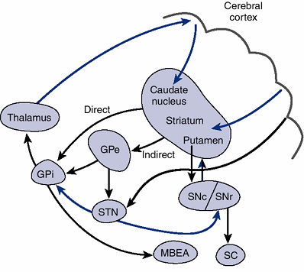

Slide 10
DIRECT PATHWAY.
The overall action of the direct pathway is to enhance motor activity.
In the direct pathway, the striatum projects to the internal segment of the globus pallidus (and to the pars reticulata of the substantia nigra.
This projection is inhibitory, and the main transmitter is GABA.
The internal segment of the globus pallidus projects to the VA and VL nuclei of the thalamus.
These connections also use GABA and are inhibitory.
The VA and VL nuclei send excitatory connections to the prefrontal, premotor, and supplementary motor cortex.
This input to the cortex influences motor planning, and it also affects the discharges of corticospinal and corticobulbar neurons.
Notes:
The direct pathway appears to function as follows. Neurons in the striatum have little background activity, and during movements they are activated by their inputs from the cortex. In contrast, neurons in the internal segment of the globus pallidus have a high level of background activity. When the striatum is activated, its inhibitory projections to the globus pallidus slow the activity of pallidal neurons. However, the pallidal neurons themselves are inhibitory, and they normally provide a tonic inhibition of neurons in the VA and VL nuclei of the thalamus. Therefore, activation of the striatum causes disinhibition of the neurons of the VA and VL nuclei. Thus, the disinhibition excites these neurons, and consequently excites their target neurons in the motor areas of the cerebral cortex. Because the motor cortex evokes movements by activating α- and γ-motor neurons in the spinal cord and brainstem, the basal ganglia can regulate movements by enhancing the activity of neurons in the motor cortex.

Slide 11
INDIRECT PATHWAY
The Striatum-GPe-STN-GPi
The overall effect of the indirect pathway is to INHIBIT MOVEMENT.
In this pathway, GPe neurons are inhibited by the GABA released from the Striatum. The GPe normally releases GABA in the STN, and thereby inhibits it.
Therefore, striatal inhibition of the GPe results in the disinhibition of neurons of the STN. The STN neurons are normally active, and they excite neurons in the GPi by glutamate. When the neurons of the STN become more active because of disinhibition, they release more glutamate in the GPi.
This excites neurons in the GPi, and consequently activates inhibitory projections that affect the VA and VL thalamic nuclei.
The activity of the thalamic neurons decreases, as does the activity of the cortical neurons that they influence.
The direct and indirect pathways thus have opposing actions; an increase in the activity of either one of these pathways might lead to an imbalance in motor control.
Such imbalances, which are typical of basal ganglion diseases, may alter the motor output of the cortex

Slide 12
ROLE OF THE SNr
Dopamine is the neurotransmitter used by neurons of the SNc.
In the nigrostriatal pathway, the release of dopamine has an overall excitatory action on the direct pathway and an inhibitory action on the indirect pathway. (Promotes movement).
This difference is caused by the action of dopamine on different types of dopamine receptors found in the GPi and GPe (D1 receptors, which are excitatory in GPi and in the GPe D2 receptors, which are inhibitory).
The overall consequence of dopamine release in both cases is a facilitation of activity in the motor areas of the cerebral cortex.
A loss of the dopaminergic neurons of the SNc is a crucial factor in the bradykinesia that is found in Parkinson's disease.

Slide 13
Role Of The Basal Ganglia In Motor Control
The basal ganglia mainly influence the motor cortex and therefore has an important influence on the lateral system of motor pathways.
However, the basal ganglia also must regulate the medial motor pathways. Diseases of the basal ganglia can also affect posture and tone of the proximal muscles.
The deficits seen in the various basal ganglion diseases include
  Abnormal movements (dyskinesias),
  Increased muscle tone (cogwheel rigidity), and
  Slowness in initiating movements (bradykinesia).
Abnormal movements include :
  Tremor, a "pill-rolling" tremor that occurs when the limb is at rest.
  Athetosis, consists of slow, writhing movements of the distal parts of the limbs.
  Chorea, characterized by rapid, flicking movements of the extremities and facial muscles
  Ballism, associated with violent, flailing movements of the limbs (ballistic movements)
  Dystonia slow truncal movements that distort the body positions

Slide 14
Parkinson's disease
A common disorder that is characterized by tremor, rigidity, and bradykinesia.
This disease is caused by loss of neurons in the SNc. Consequently, the striatum suffers a severe loss of dopamine.
Neurons of the locus coeruleus and the raphe nuclei, as well as of other monoaminergic nuclei, are also lost.
The loss of dopamine diminishes the activity of the direct pathway and increases the activity of the indirect pathway.
The net effect is an increase in the activity of neurons in the GPi. This results in a greater inhibition of the neurons in the VA and VL nuclei, and a less pronounced activation of the motor cortical areas. The consequence is slowed movements (bradykinesia).
Before the dopaminergic neurons are completely lost, administration of L-dopa a precursor of dopamine can relieve some of the motor deficits in Parkinson's disease.

Slide 15
Huntington's disease
This results from a genetic defect that involves an autosomal dominant gene.
This defect leads to the loss of GABAergic and cholinergic neurons of the striatum (and also degeneration of the cerebral cortex, with a resultant dementia).
Loss of inhibition of the GPe diminishes the activity of neurons in the STN.
Hence, the excitation of neurons of the GPi would be reduced.
This will disinhibit the neurons in the VA and VL nuclei. The resulting enhancement of activity in neurons in the motor areas of the cerebral cortex may help explain the CHOREIFORM MOVEMENTS of Huntington's disease.
The rigidity in Parkinson's disease may in a sense be the opposite of chorea, because overtreatment of patients with Parkinson's disease with L-dopa can result in chorea.

